Slide 1

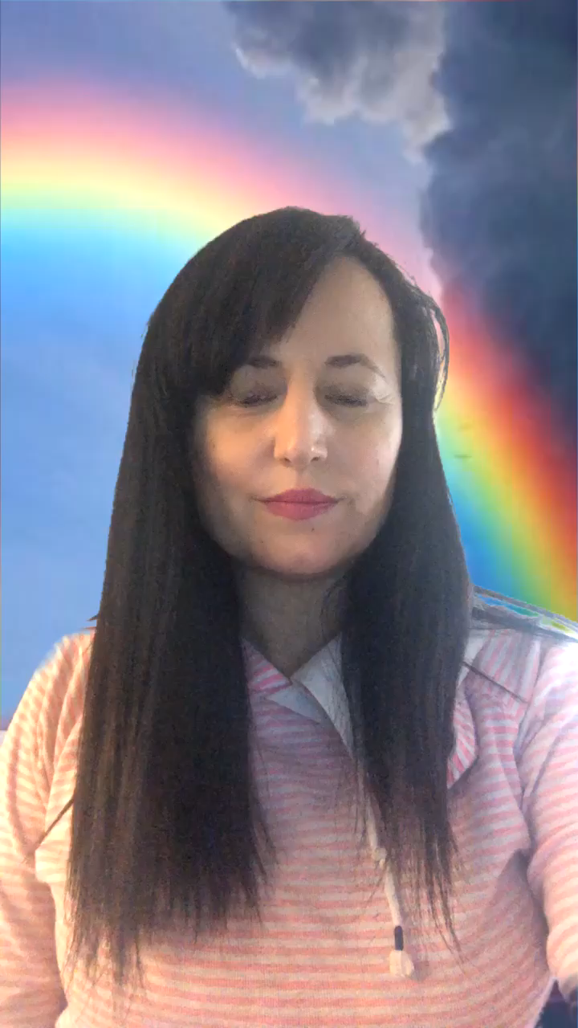


Session 2
Gratitude

Slide 2
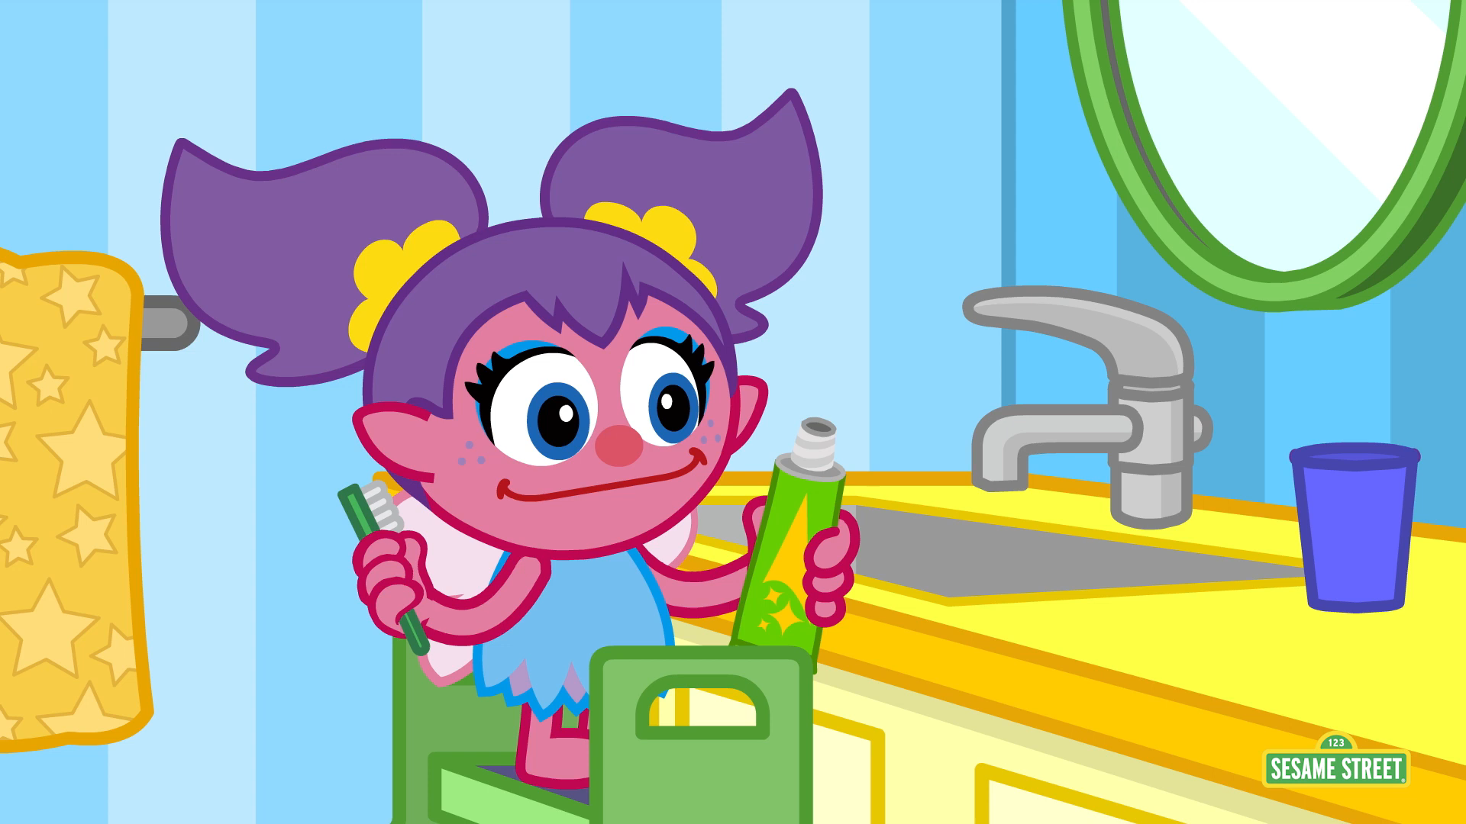
Watch Abbie go about her day and talk to a grown up about the things that you are grateful for, there will always be something, no matter how small. Thinking this way can really cheer us up, especially on days when we are feeling sad or things don’t feel like they are going right. Try and build gratitude into your day, every day and notice the difference.

Slide 3

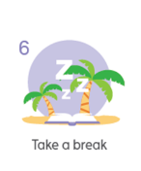
Take a break and have a go at some Gratitude mindfulness

Slide 4
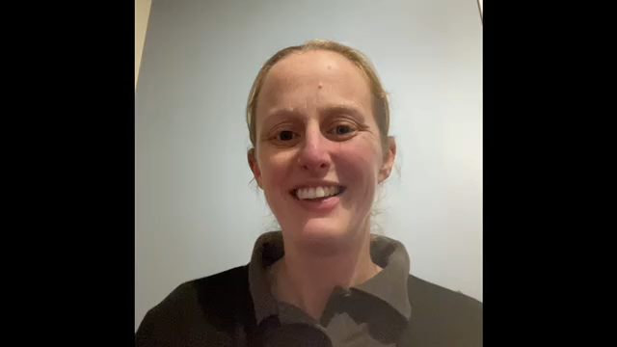
This is Paula Baker from HeadsUp, a local organisation that provides support and tips for promoting Mental Health. Paula comes into some of the schools in our federation and works with us.
https://headsupmha.com/

Slide 5
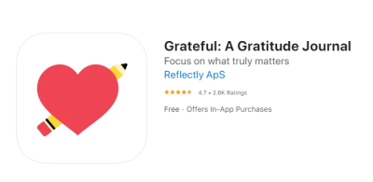
Other ideas for things you can do to promote gratitude:
Make a paper chain that you add to each day with things that you appreciate and are grateful for
Keep a gratitude jar, decorate it. Each day add a few slips of paper with the things you have appreciated and been grateful for that day
Keep a gratitude journal with your grown up. Use a notebook or an app to write down at least three things each day.
Do a Thankful scavenger hunt like Abbie in the video.
There are some brilliant apps that you can use on a phone or tablet. You can often add photos too which are lovely to look back on over time.
This is a nice, simple one

