Slide 1


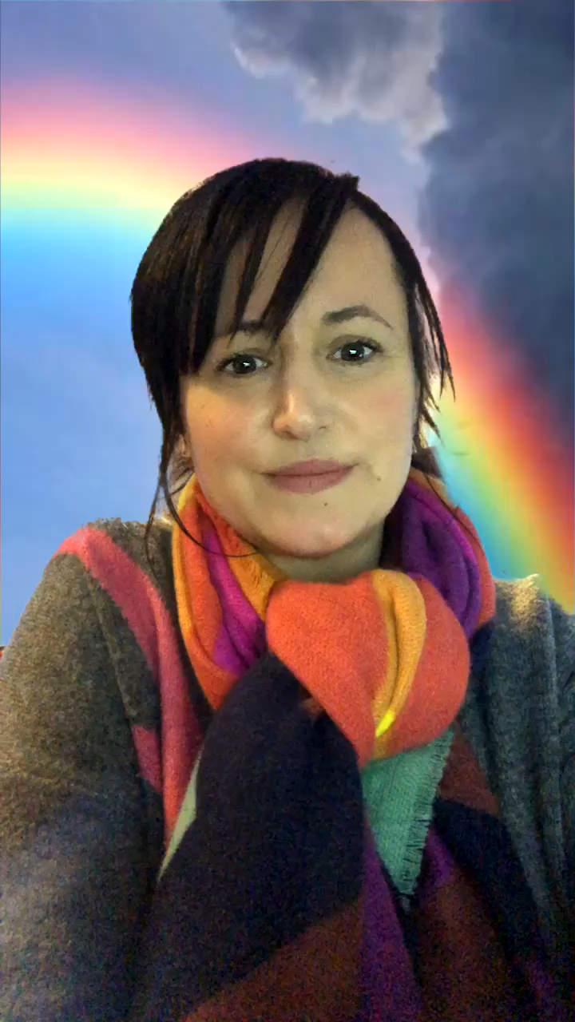

Session 5
Sharing Our Worries

Slide 2
This week’s focus

Slide 3

Listen to this story ‘The Huge Bag of Worries’ by Virginia Ironside, read by Lewis Kirk. Do you ever have any worries like Jenny?

Slide 4

Activity Time!
Draw a bag on a piece of paper, or use an actual bag you have at home. Draw or write any worries that you might have in the bag, or if you are using an actual bag, put them on pieces of paper and pop them in. Look at them one at a time with your grown up and think about what you could do about these worries. Making a plan together can help those worries go away.

Slide 5

Breathing deeply is another brilliant technique for calming our mind when we are feeling worried. Have a go at this relaxation video (Created by The Mindfulness Teacher – YouTube)

