Slide 1


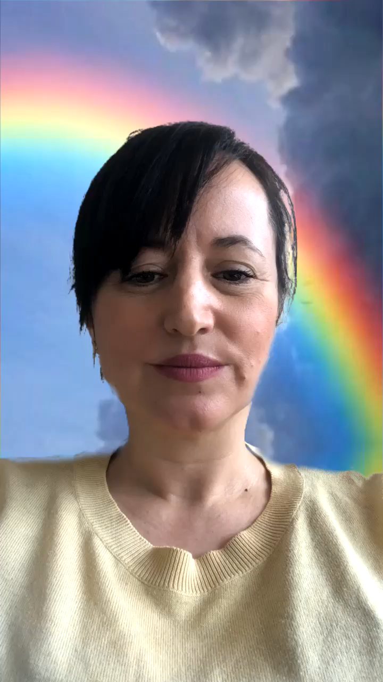


Session 3

Slide 2


Watch the video, how many ways can you see people expressing themselves?
How do you like to express yourself? Do you like to paint? Dance? Dress Up? Play music? Sing? Make things?

Slide 3
This week’s focus

Slide 4

Do something you are good at and share it with your family.
Teach someone in your family to do something you are good at, e.g. drawing, playing an instrument, juggling
Spend time doing something that you love!
Make something, create something, dance to your favourite music, wear your favourite clothes or clothes that make you smile, tell some jokes, sing along to your favourite song……….
Express yourself and have fun!!
Print out a photo of yourself or draw a picture. Then cut and stick pictures from magazines or draw pictures of things you love doing all around you. Stick it up in your bedroom to remind yourself of all the things you love to do. Choose something from there when you are feeling bored or fed up. It will give you a boost!

Slide 5

Turn this one up LOUD and dance around the room (preferably dressed up in a wacky outfit!)
What are you? Are you friendly? Are you kind? You could draw a picture of yourself and describe what you are like or ask your family to describe you.

Slide 6

Time to Relax

